Slide 1

Spotted Python
Week 9 Tutorial
Photometric redshift

Slide 2

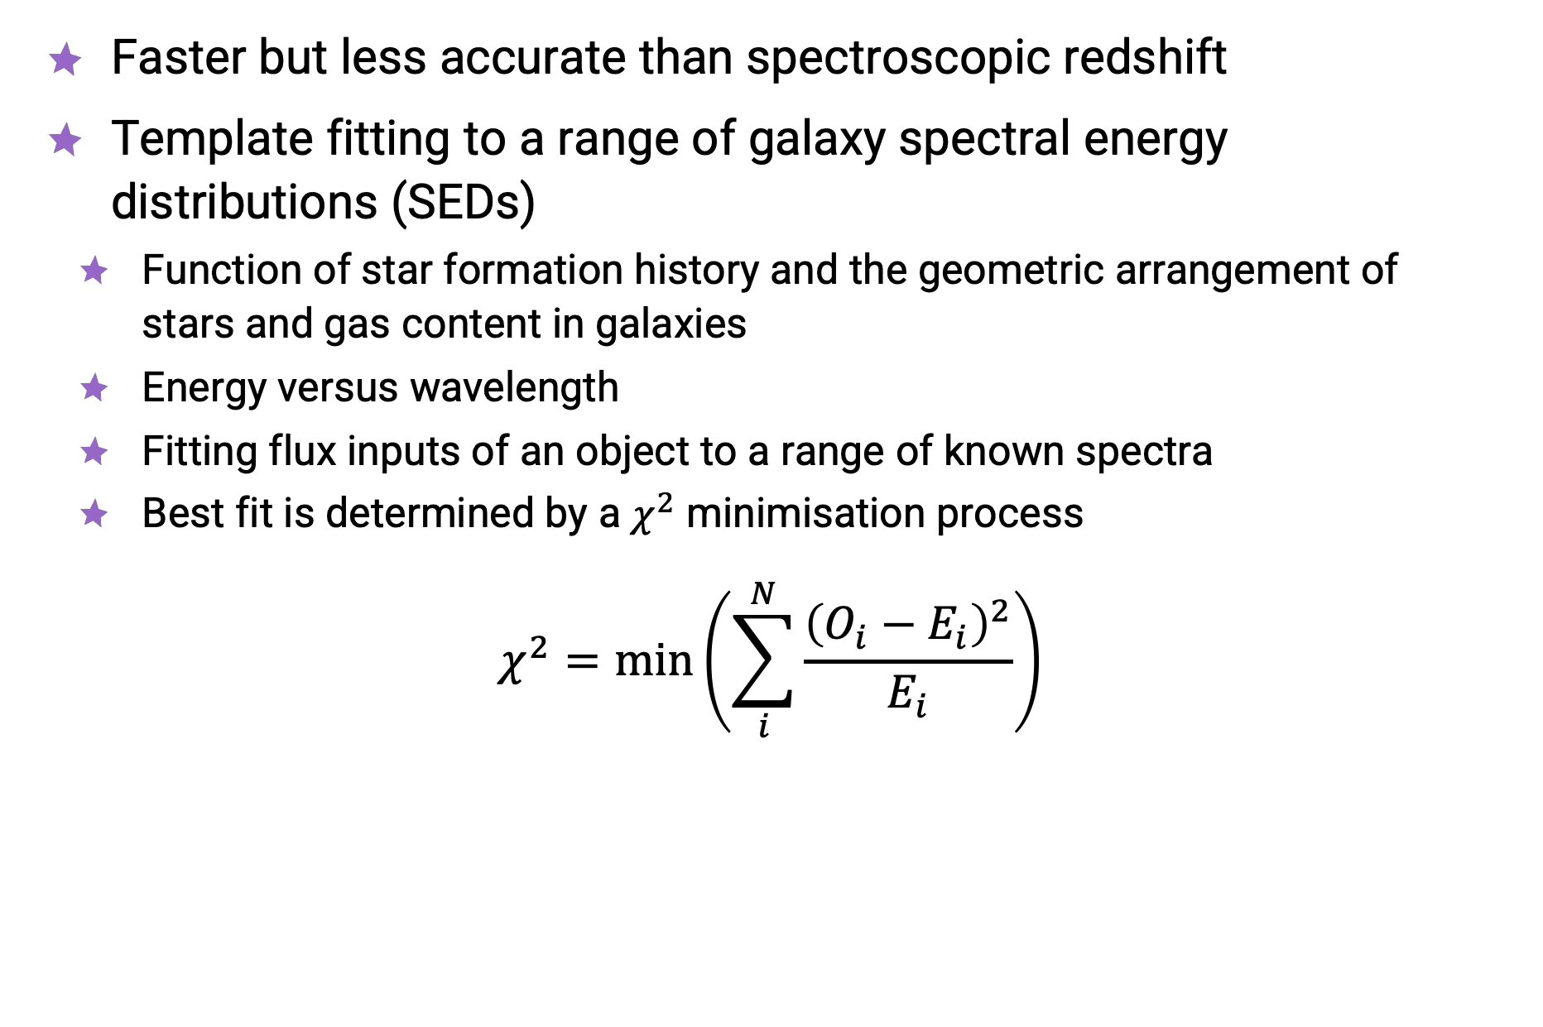
Photometric Redshift
Faster but less accurate than spectroscopic redshift
Template fitting to a range of galaxy spectral energy distributions (SEDs)
  Function of star formation history and the geometric arrangement of stars and gas content in galaxies
  Energy versus wavelength
  Fitting flux inputs of an object to a range of known spectra
  Best fit is determined by a $χ^{2}$ minimisation process
$$χ^{2}=min\left(\sum_{i}^{N}{\frac{{\left(O_{i}−E_{i}\right)}^{2}}{E_{i}}}\right)$$

Slide 3
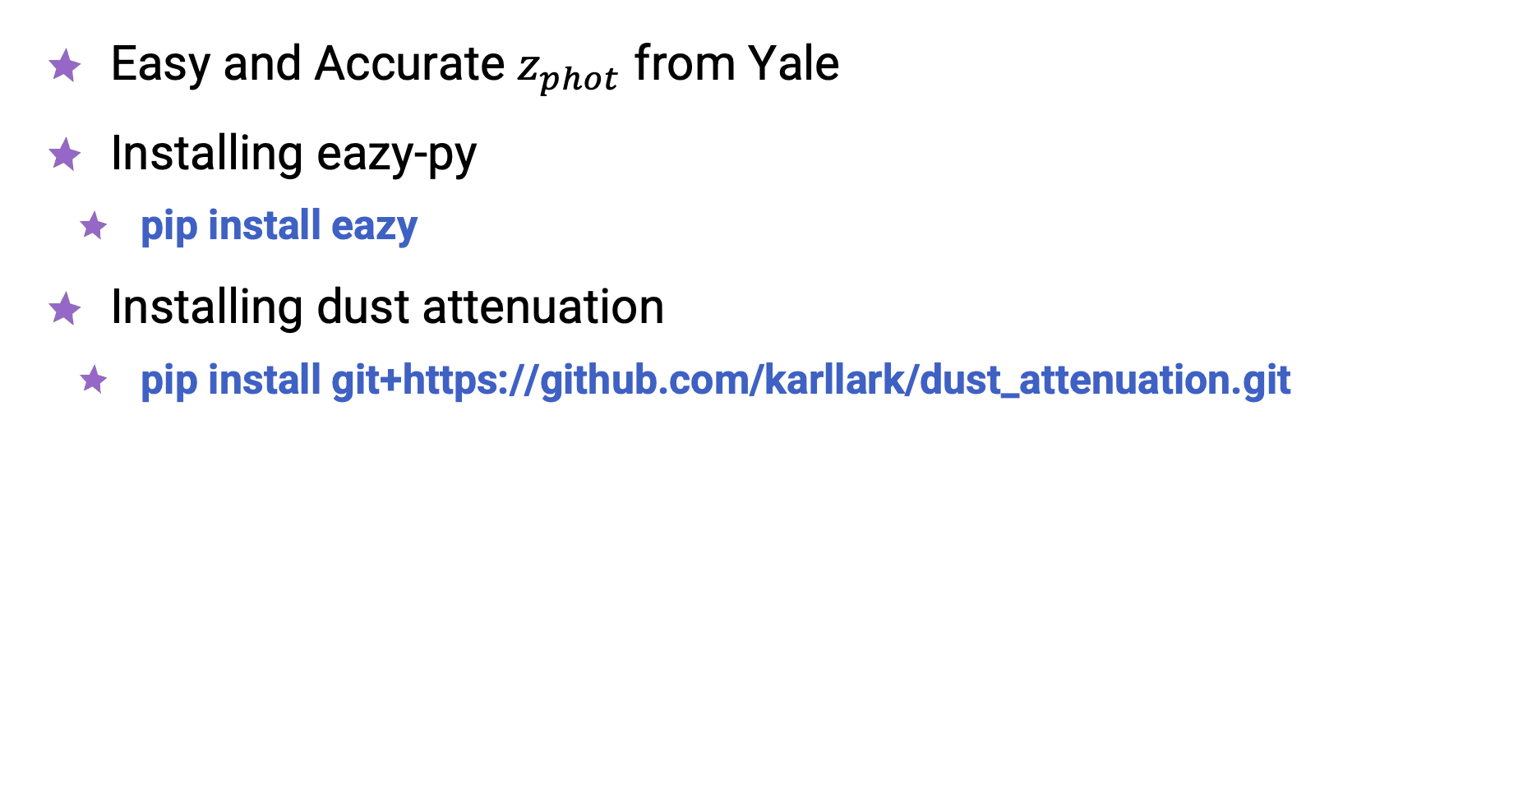
Running EAZY
Easy and Accurate $z_{phot}$ from Yale
Installing eazy-py
  pip install eazy
Installing dust attenuation
  pip install git+https://github.com/karllark/dust_attenuation.git

Slide 4
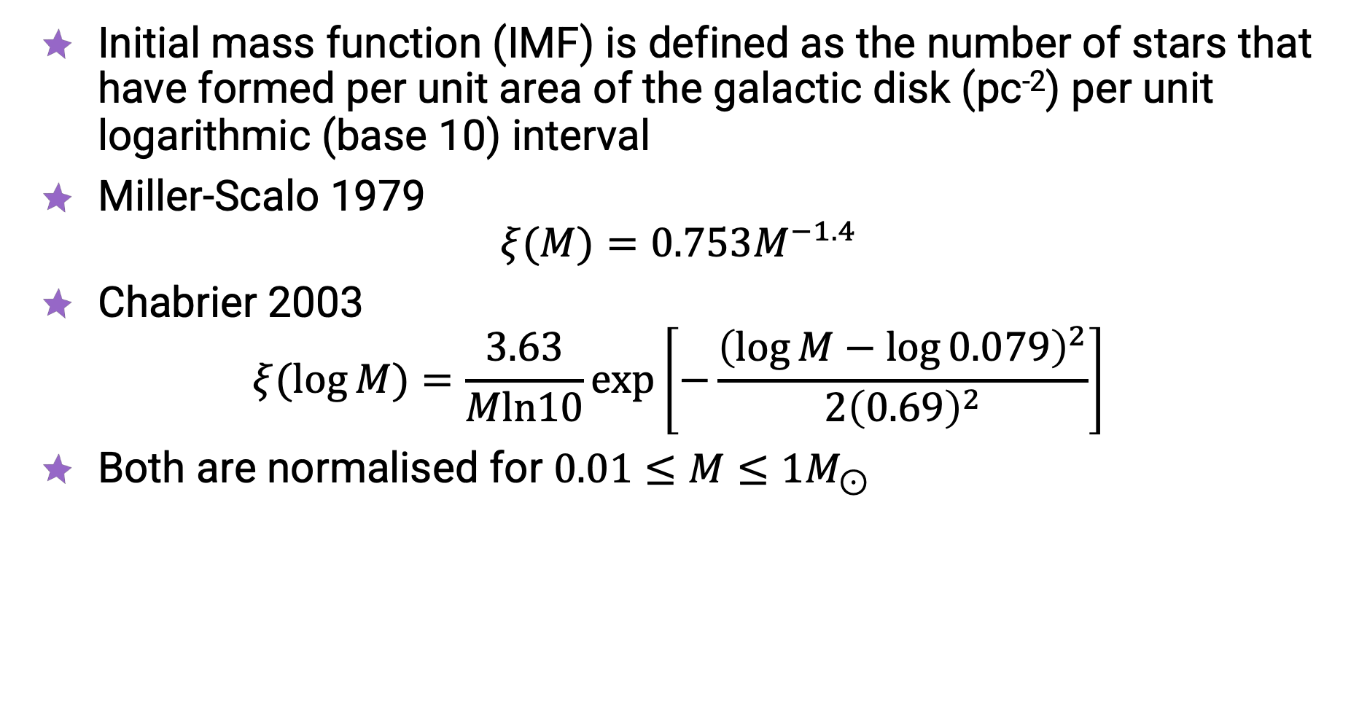
Initial Mass Function
Initial mass function (IMF) is defined as the number of stars that have formed per unit area of the galactic disk (pc⁻²) per unit logarithmic (base 10) interval
Miller-Scalo 1979
$ξ(M)=0.753M^{−1.4}$
Chabrier 2003
$ξ(\log{M)}=\frac{3.63}{Mln10}\exp\left[−\frac{{\left(\log{M}−\log{0.079}\right)}^{2}}{2{\left(0.69\right)}^{2}}\right]$
Both are normalised for $0.01≤M≤1M_{⊙}$

Slide 5
Integration
scipy.integrate
    https://docs.scipy.org/doc/scipy/tutorial/integrate.html
    Provides several integration techniques
np.trapz
    https://numpy.org/doc/1.15/reference/generated/numpy.trapz.html
    Integrates along the given axis using the composite trapezoidal rule
Complete Exercise 1

Slide 6
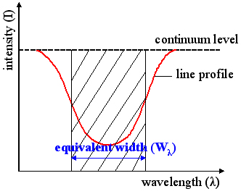
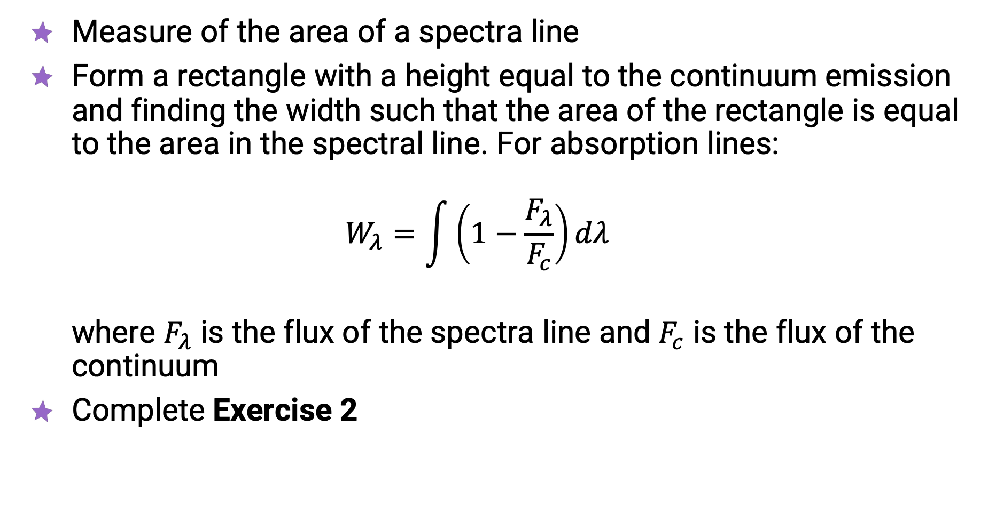
Equivalent Width
Measure of the area of a spectra line
Form a rectangle with a height equal to the continuum emission and finding the width such that the area of the rectangle is equal to the area in the spectral line. For absorption lines:
$W_{λ}=\int{\left(1−\frac{F_{λ}}{F_{c}}\right)}dλ$
where $F_{λ}$ is the flux of the spectra line and $F_{c}$ is the flux of the continuum
Complete Exercise 2

Slide 7
Cosmological Calculator
https://cosmocalc.icrar.org/
astropy.cosmology
    https://docs.astropy.org/en/stable/cosmology/index.html
Test the consequences of changing the cosmological parameters

